Slide 1
Intelligent Plagiarism and Near‑Duplicate Document Detection System
PBL Review – 2
Team Members
2510030269 — Snigdha Patlolla
2510030123 — Komala Shravya

Slide 2

Why Intelligent Plagiarism Detection?
Traditional systems detect exact or highly similar text — limited against obfuscation.
Modern plagiarism uses paraphrasing, synonym swap, sentence reordering, and structural edits.
Near‑duplicate documents can be semantically equivalent despite different wording.
NLP and embeddings enable similarity detection based on meaning and context.
Proposed system fuses lexical and semantic methods for robust coverage.
Process Flow
Upload Docs
Extract Text
Preprocess
Compute Similarity
Flow shows pipeline stages used to compute fused similarity and classification.

Slide 3
References
Grozea, C., Gehl, C., & Popescu, M. (2009). ENCOPLOT: Pairwise Sequence Matching in Linear Time Applied to Plagiarism Detection. PAN at CLEF 2009.
Nawab, R. M. A., Stevenson, M., & Clough, P. (2011). External Plagiarism Detection using Information Retrieval and Sequence Alignment. PAN at CLEF 2011.
Knuth, D. E., Morris, J. H., & Pratt, V. R. (1977). Fast Pattern Matching in Strings. SIAM Journal on Computing, 6(2), 323–350.
Sedgewick, R., & Wayne, K. (2011). Algorithms, 4th Edition. Addison-Wesley. Section 5.3: Substring Search.
Meuschke, N., & Gipp, B. (2013). State-of-the-art in detecting academic plagiarism. International Journal for Educational Integrity, 9(1), 50–71.

Slide 4
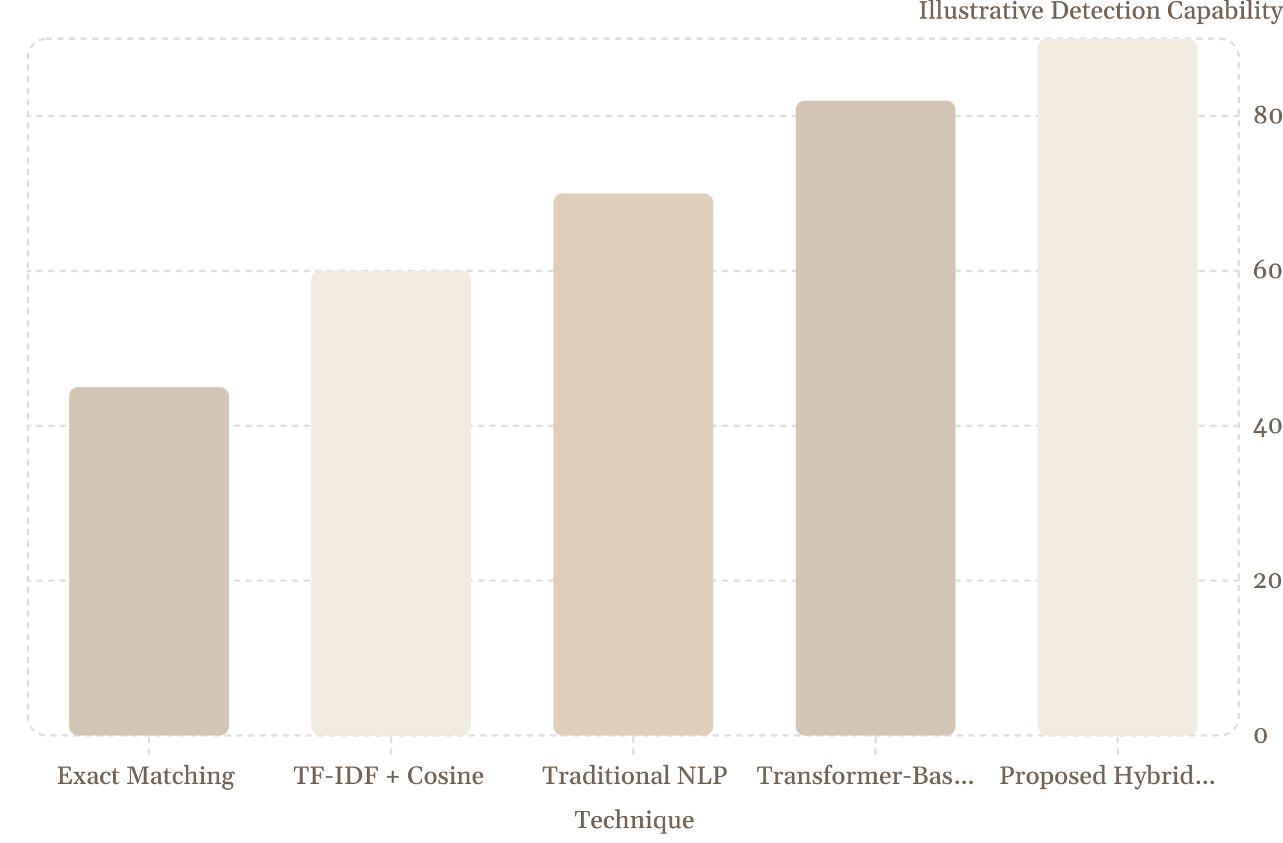
Technique Comparison — Illustrative Capability
Key observations
Exact matching is effective for verbatim copying but fails with paraphrase.
Semantic models detect contextual similarity even with rewording.
Hybrid systems combining lexical and semantic signals broaden detection coverage.
Note: Illustrative comparison — not experimental results.

Slide 5

Near‑Duplicate Documents — What to Expect
Similarity Spectrum
Document Type
Example Characteristics
Detection Challenge
Exact Duplicate
Same sentences and wording
Easy to detect
Paraphrased
Paraphrased Copy
Same meaning, different wording
Requires semantic analysis
Partially Similar
Unrelated
Near‑Duplicate
Mostly similar with structural edits and insertions
Requires combined lexical + semantic analysis
Exact Duplicate
Highly Similar
Editable horizontal scale shows gradation from verbatim to unrelated content.

Slide 6
Analysis — Research Gap
Summary gap analysis highlighting where prior work falls short and what the proposed system addresses.
Requirement
Existing
Proposed System
Exact Copy Detection
✓
✓
Keyword Similarity
✓
✓
Paraphrase Detection
Limited
✓
Semantic Similarity
Limited
✓
Near‑Duplicate Detection
Partial
✓
Explainable Similarity Score
Partial
✓
Combined Analysis
Limited
✓
RESEARCH GAP
Existing approaches often prioritise either lexical matching or semantic similarity. A comprehensive, explainable fusion is needed to detect verbatim copying, paraphrase, and near‑duplicates at scale.

Slide 7
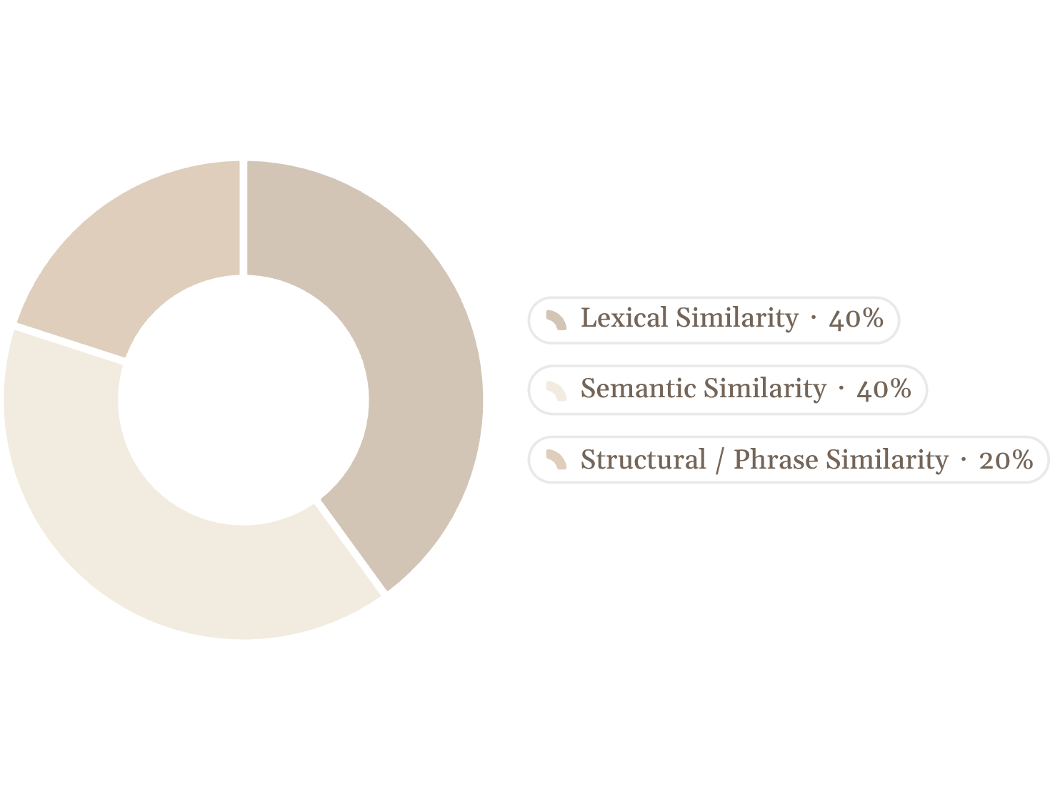
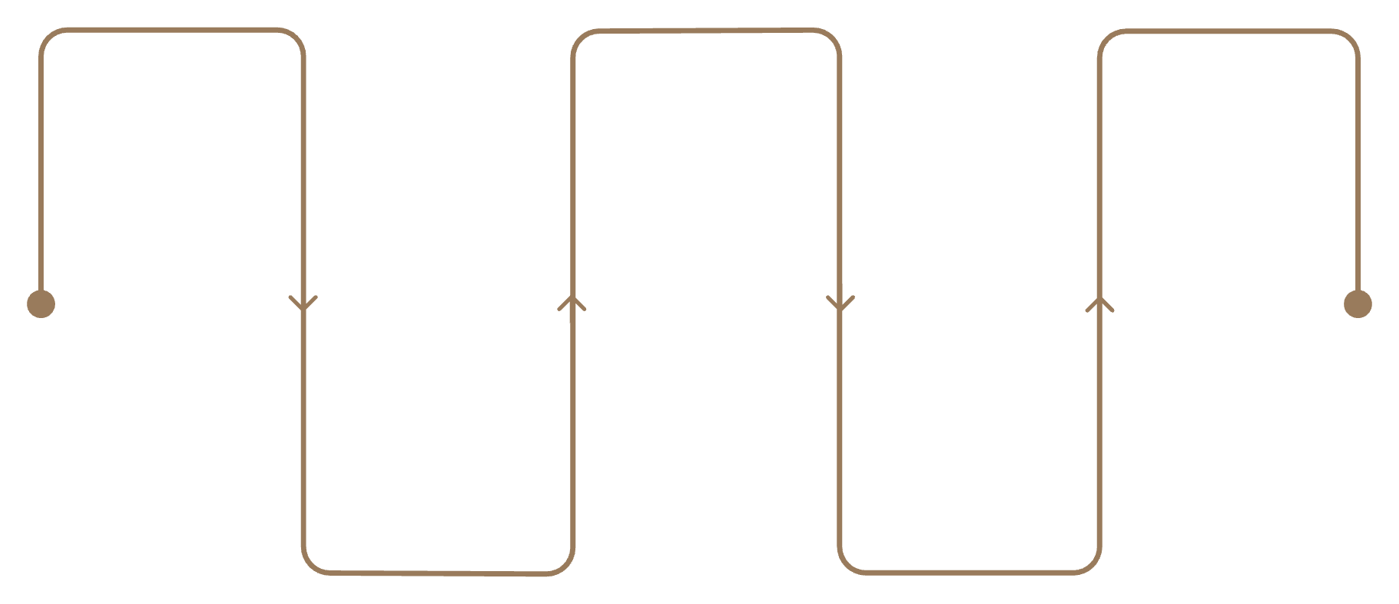
Proposed System — Architecture & Weighting
Illustrative Contribution of Detection Signals
Input Docs
Lexical Module
Fusion & Classify
Source documents for analysis
TF-IDF, cosine, phrase matching
Fuse scores, label originality and duplicates
Preprocessing
Semantic Module
Tokenize, normalize, remove stop-words
Sentence embeddings and contextual similarity
Pipeline emphasises modular design, explainability, and fusion of multiple signals for robust classification.
Note: Illustrative system design weighting — to be validated during implementation.

Slide 8


Conclusion, Expected Outcome & References
Conclusion
Effective detection requires recognising both textual overlap and semantic similarity.
State-of-the-art systems excel at text matching but struggle with paraphrase and structural edits.
Near‑duplicate detection needs fused lexical and semantic analysis for reliable results.
Our hybrid approach targets accuracy, scalability and interpretability for academic use.
References (compact academic format)
Turnitin — similarity and plagiarism detection technology (company materials).
PlagScan — plagiarism detection systems and technical overview.
Salton, G. et al. — TF‑IDF and cosine similarity fundamentals (classic IR literature).
Devlin, J. et al. — BERT: Pre-training of deep bidirectional transformers for language understanding.
Research on paraphrase identification and near‑duplicate detection — overview and surveys.
Expected Outcome
Upload Documents
Analyze Similarity
All charts with numeric values are illustrative comparisons — not experimental results.
Generate Report
Classify Documents

Slide 9
THANK YOU

